Slide 1
Lecture 2
PLANNING PROCESSES
INTERACTION

Slide 2
Contents
PROJECT MANAGEMENT PROCESSES
Common Project Management Process Interactions
Project Management Process Groups
Initiating Process Group
Planning Process Group
Executing Process Group
Monitoring and Controlling Process Group
Closing Process Group
Project Information
Role of the Knowledge Area

Slide 3
Overview
INTEGRATIVE UNDERTAKINGS
Project Management is an integrative undertaking that requires each project and product process to be appropriately aligned and connected with the other processes to facilitate coordination.
Actions taken during one process typically affect that process and other related processes.
Actively manages these interactions to meet sponsor, customer, and other stakeholder requirements.
Sometimes, a process or a set of processes will need to be iterated several times in order to achieve the required outcome.

Slide 4
COMMON
PROJECT MANAGEMENT
PROCESS INTERACTIONS
The project management processes overlap and interact in ways that are not completely detailed in this document.
Most experienced project management practitioners recognize there is more than one way to manage a project.
The required Process Groups and their processes are guides for applying appropriate project management knowledge and skills during the project.
The application of the project management processes is iterative, and many processes are repeated during the project.

Slide 5
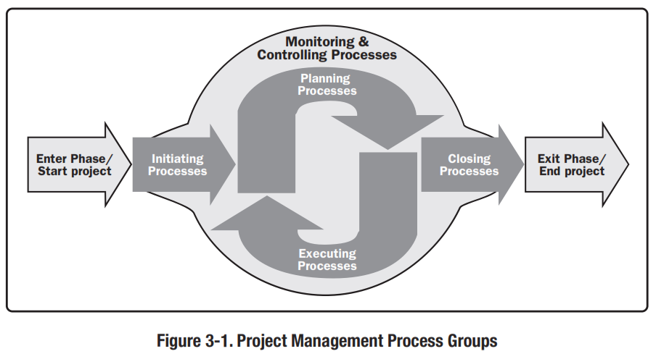
PROCESS INTERACTIONS
PROCESS GROUP
The integrative nature of project management requires the Monitoring and Controlling Process Group to interact with the other Process Groups.
Monitoring and Controlling Process occur at the same time as processes contained within other Process Groups.
Monitoring and Controlling Process is pictured as a “background” Process Group for the other four Process Groups.

Slide 6
PROCESS INTERACTIONS
CHARACTERISTICS
Project management Process Groups are linked by the outputs which are produced.
The Process Groups are seldom either discrete or one-time events.
They are overlapping activities that occur throughout the project.
The output of one process generally becomes an input to another process or is a deliverable of the project, subproject or project phase.
Deliverables at the subproject or project level may be called incremental deliverables.

Slide 7
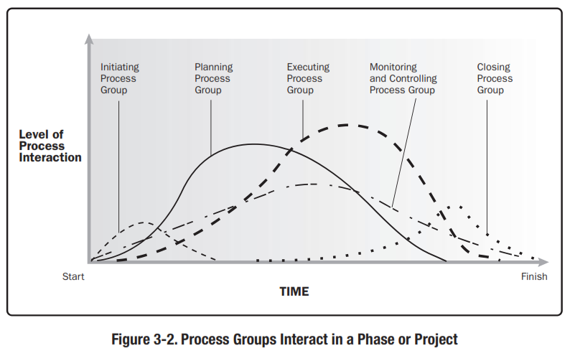
PROCESS INTERACTIONS
CHARACTERISTICS
The Planning Process Group provides the Executing Process Group with the project management plan and the project documents.
Process Groups interact and shows the level of overlap at various times.
If the project is divided into phases, the Process Group interact within each phase.

Slide 8
PROCESS INTERACTIONS
An EXAMPLE
An example

Slide 9
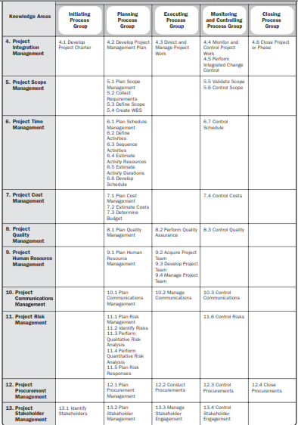

Slide 10
Mapping the Process Groups to the Knowledge Areas
You can map the main activities of each PM process group into the nine knowledge areas by using the PMBOK® Guide 2004.
Note that there are activities from each knowledge area under the planning process group.
All initiating activities are part of the project integration management knowledge area.

Slide 11
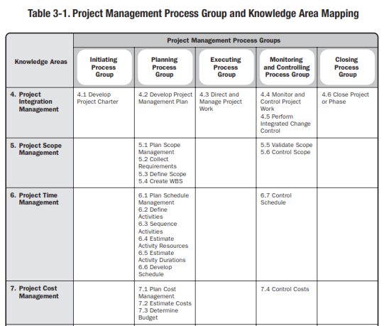

Slide 12
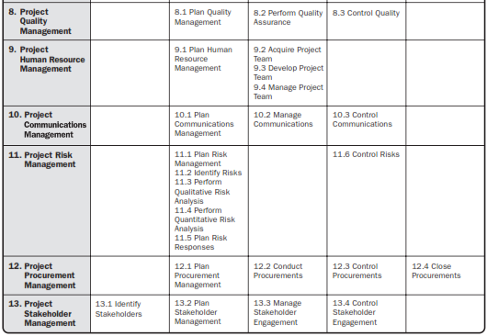

Slide 13
Project Process Groups
Use the project plan to manage the project
Conduct regular status meetings
Create and distribute regular status reports
Track planned vs actual and update project plan
Keep the project plan current
Track and escalate issues and risks
Quality assurance
Track Lessons Learned
Execute
the Project
Ensure that the project scope is clearly defined and approved
Verify that project is staffed appropriately
Establish leadership and project structure
Define roles and responsibilities
Develop project org chart and contact list
Communicate with project team, Functional Managers and other Stakeholders
Develop project communication plan
Develop other plans (quality, change, acceptance)
Identify high level risks and cross functional impacts
With your team, develop estimates and build a project plan
Ensure that the project plan is realistic and approved
Plan
the Project
3
Control
the Project
4
2
Ensure appropriate approvals of deliverables occur
Conduct performance review checkpoints (quality, time, budget, lessons learned)
Take required corrective action
Issue change requests
Make changes and adjust the baseline
Implement contingency plans
5
Close
the Project
1
Determine the following:
Project objectives
Business need
High level project deliverables
High level constraints and assumptions
High level cross functional impacts
High level resource needs
Distribute final status report
Collect and compile lessons learned from team
Facilitate a Post Project Review Meeting
Ensure appropriate final acceptance approvals occur
Finalize project documentation and file in project archives
Initiate the
Project

Slide 14
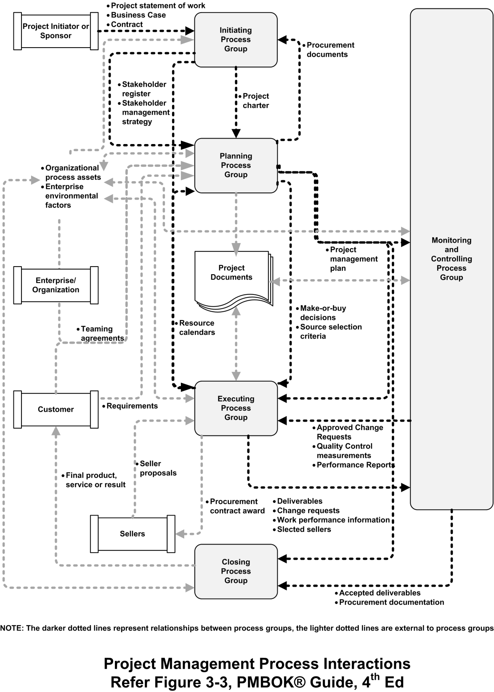

Slide 15
Project Initiation
Initiating a project includes recognizing and starting a new project or project phase.
Some organizations use a pre-initiation phase, while others include items such as developing a business case as part of the initiation.
The main goal is to formally select and start off projects.
Key outputs include:
Assigning the project manager.
Identifying key stakeholders.
Completing a business case.
Completing a project charter and getting signatures on it.

Slide 16
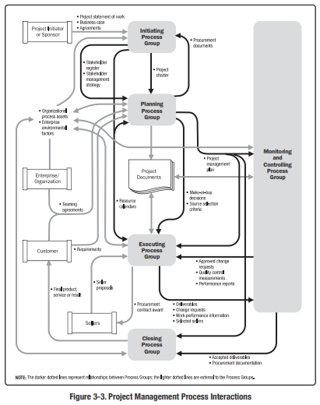
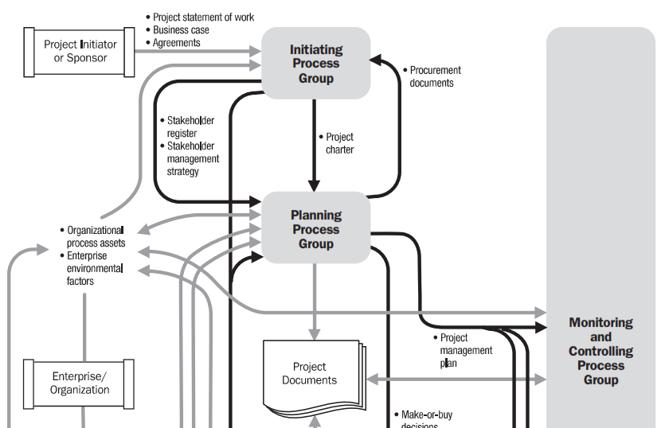

Slide 17
Project Planning
The main purpose of project planning is to guide execution.
Every knowledge area includes planning information
Key outputs included :
A team contract.
A scope statement.
A work breakdown structure (WBS).
A project schedule, in the form of a Gantt chart with all dependencies and resources entered.
A list of prioritized risks (part of a risk register).

Slide 18
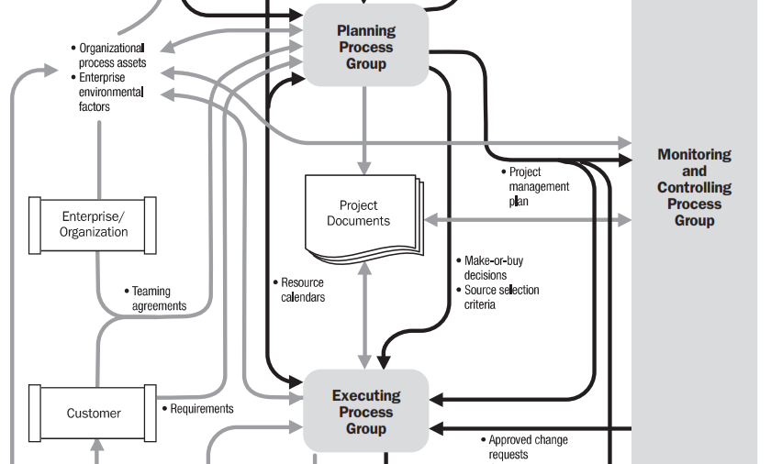

Slide 19
Project Executing
Project execution usually takes the most time and resources.
Project managers must use their leadership skills to handle the many challenges that occur during project execution.
Many project sponsors and customers focus on deliverables related to providing the products, services, or results desired from the project.

Slide 20
Project Monitoring and Controlling
Involves measuring progress toward project objectives, monitoring deviation from the plan, and taking corrective action to match progress with the plan.
Affects all other process groups and occurs during all phases of the project life cycle.
Outputs include performance reports, requested changes, and updates to various plans.

Slide 21
Project Closing
Involves gaining stakeholder and customer acceptance of the final products and services.
Even if projects are not completed, they should be formally closed in order to reflect on what can be learned to improve future projects.
Outputs include project archives and lessons learned, which are part of organizational process assets.
Most projects also include a final report and presentation to the sponsor or senior management.

Slide 22
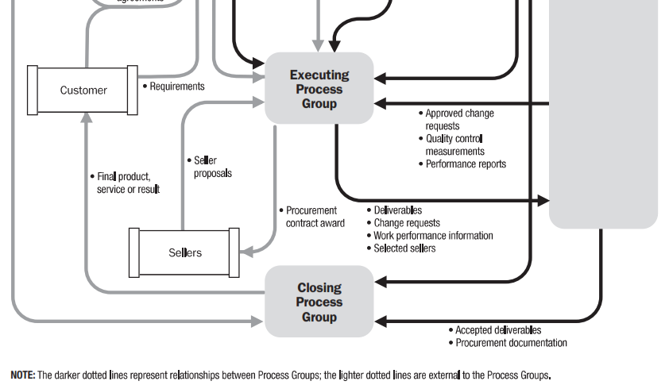

Slide 23
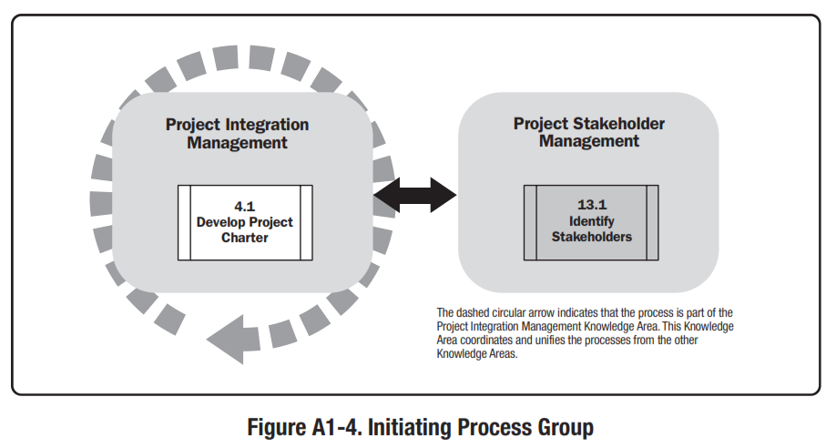
Initiating Process Group

Slide 24
Initiating Process Group

Slide 25
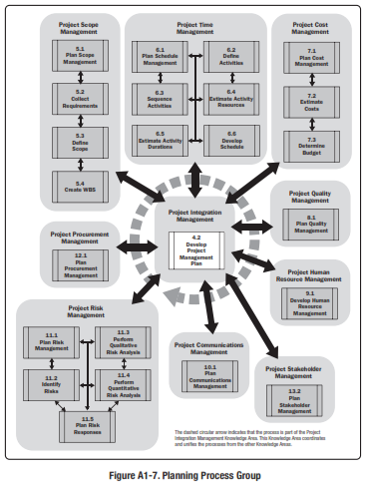
Planning Process Group

Slide 26
PLANNING
PLANNING PROCESS GROUP
Planning Process Group consists of those processes performed to
establish the total scope of the effort,
define and refine the objectives, and
develop the course of action required to attain those objectives.
The planning processes develop the project management plan and the project documents that will be used to carry out the project.
The complex nature of project management may require the use of repeated feedback loops for additional analysis.
Notes:
Chapter 5
PROJECT SCOPE MANAGEMENT
Project Scope Management includes the processes required to ensure that the project includes all the work required, and only the work required, to complete the project successfully.
Managing the project scope is primarily concerned with defining and controlling what is and is not included in the project.

Slide 27
Planning Process Group

Slide 28
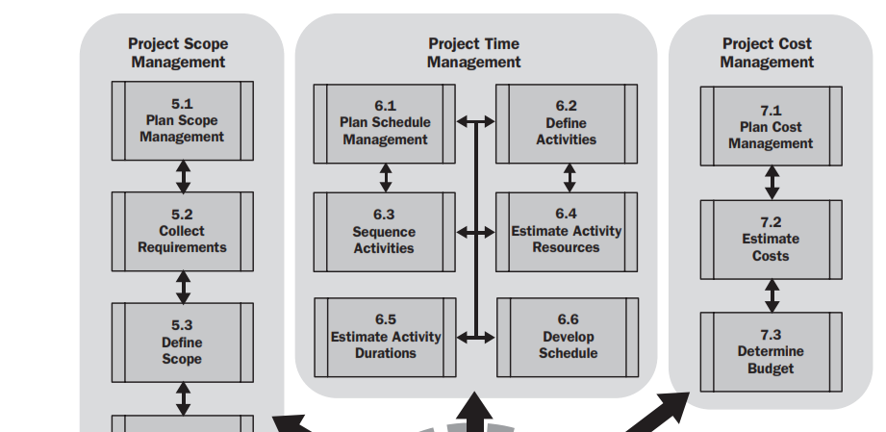
Planning Process Group

Slide 29
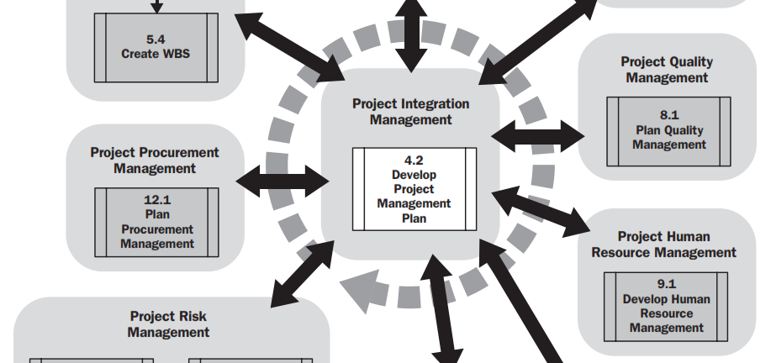
Planning Process Group

Slide 30
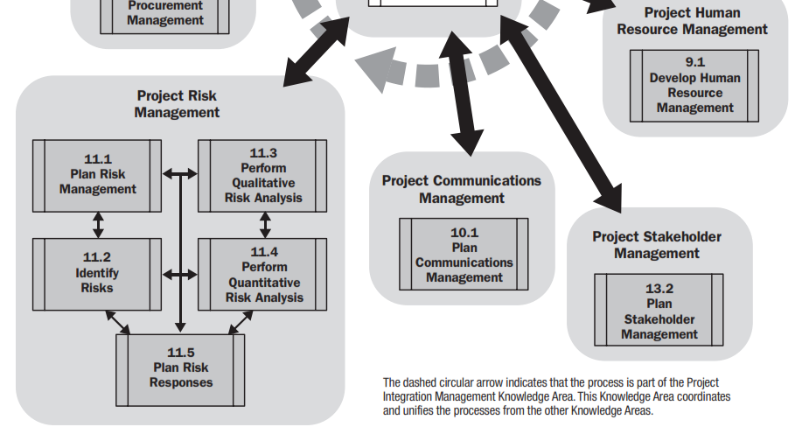
Planning Process Group

Slide 31
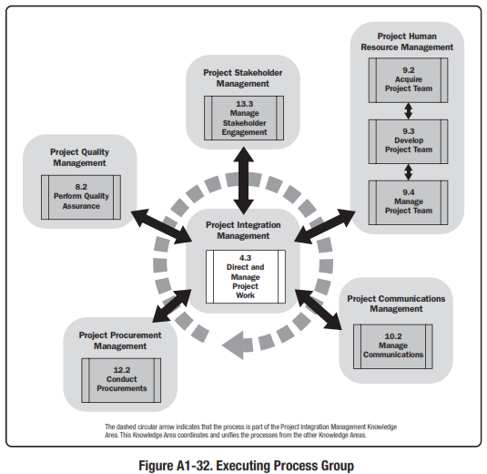
Executing Process Group

Slide 32
Executing Process Group

Slide 33
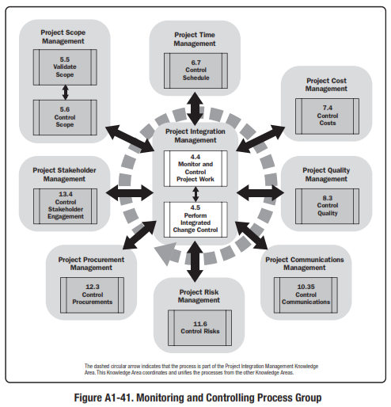
Monitoring and Control Process Group

Slide 34
Closing Process Group

Slide 35
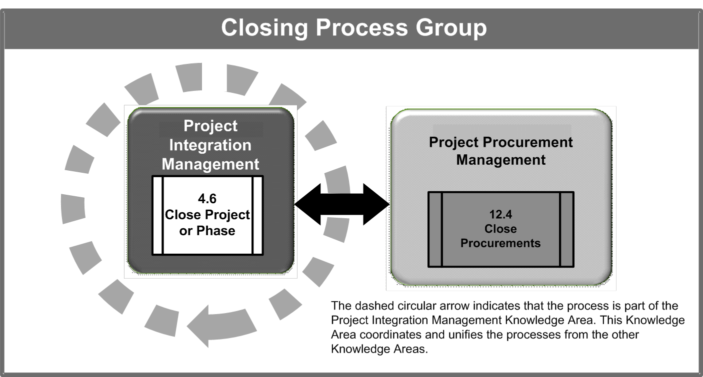
Closing Process Group

Slide 36
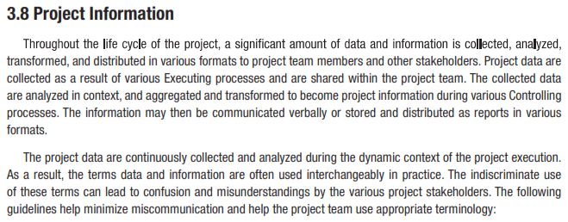
Project Information

Slide 37
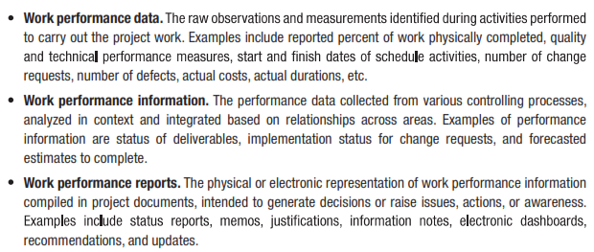
Project Information

Slide 38
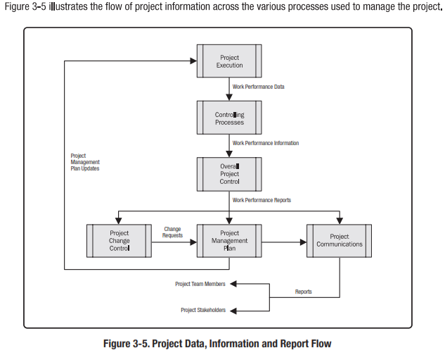
Project Information

Slide 39
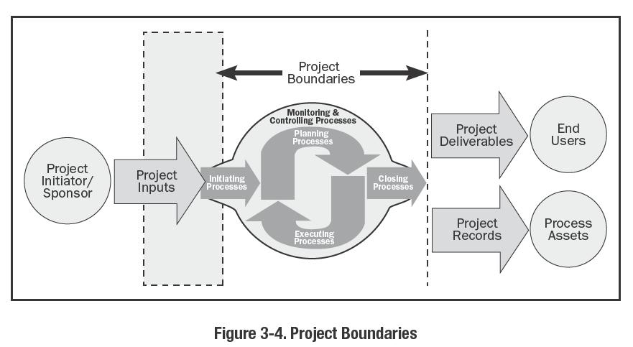
Reference: Figure 3-4.
PMBOK® Guide, 4th Ed

Slide 40
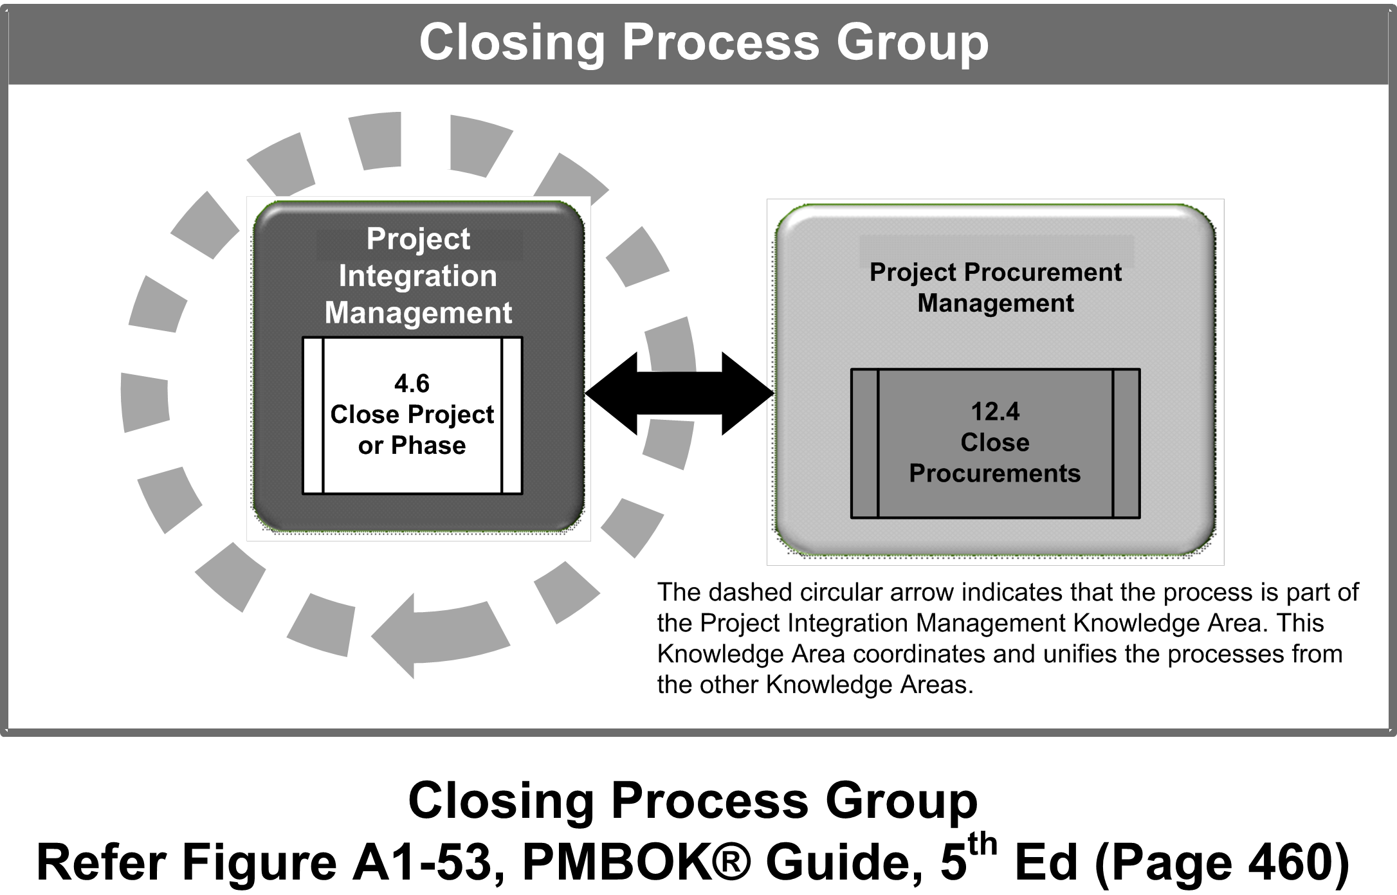

Slide 41
Thank You

